Slide 1
Change Detection Modelling
Donkin, C., Tran, S. C., & Nosofsky, R. (2014). Landscaping analyses of the ROC predictions of discrete-slots and signal-detection models of visual working memory. Attention, Perception, & Psychophysics, 76(7), 2103–2116. https://doi.org/10.3758/s13414-013-0561-7
See also: Rouder, J. N., Morey, R. D., Cowan, N., Zwilling, C. E., Morey, C. C., & Pratte, M. S. (2008). An assessment of fixed-capacity models of visual working memory. Proceedings of the National Academy of Sciences, 105(16), 5975–5979. https://doi.org/10.1073/pnas.0711295105

Slide 2
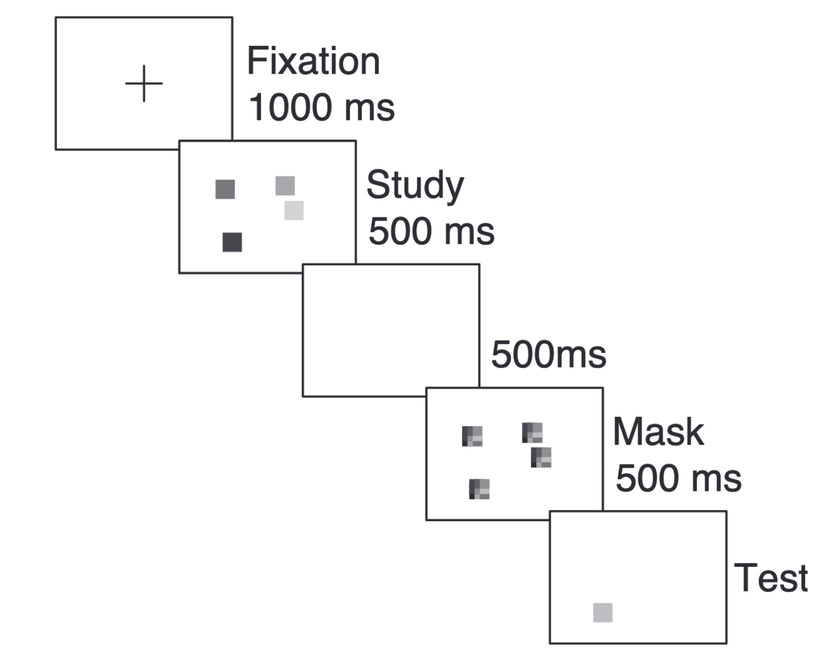
Change Detection Task
Binary response: Does test colour match study colour?
Different (= change)
Same
Three study set sizes
2, 5, 8
Set sizes randomly intermixed within block
Five change set sizes across blocks
.15, .3, .5, .7, .85
10 blocks of 50 trials
participants are informed about change proportion at beginning of block
random order of blocks
 | “change” | “same”
Change trial | Pr(“C”|C) Hit | Pr(“S”|C) Miss
Same trial | Pr(“C”|S) False Alarm | Pr(“C”|C)

Slide 3
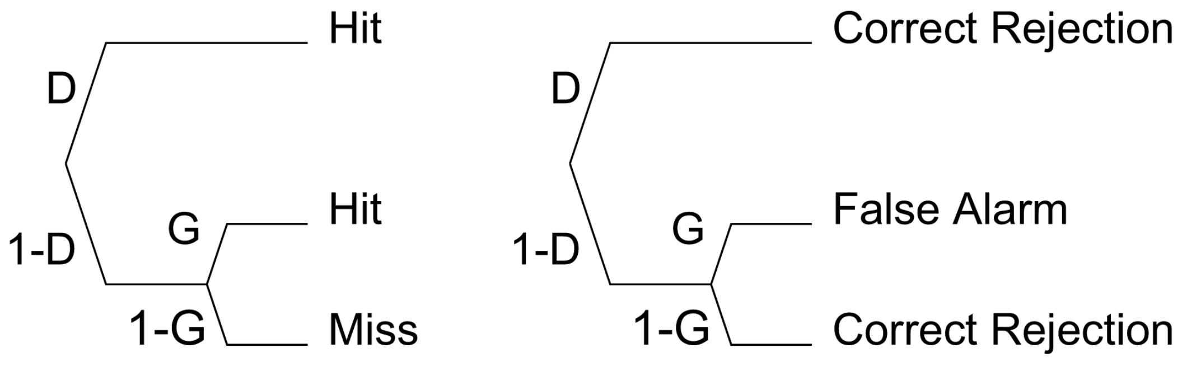
Slots Model (Cowan Variant)
Change Trial
Same Trial
D (detection, probability that study colour is in memory) = min(1; k/M), where k = memory capacity and M = study set size. [D is called m in code]
G = probability to guess “change”
Pr(Hit) = D + (1 - D) * G
Pr(False Alarm) = (1 - D) * G

Slide 4
Slots Model with Attention (Rouder et al. 2008)
Change Trial
Same Trial
a
a
1 - a
Hit
1 - a
G
False Alarm
G
1 - G
Miss
1 - G
Correct Rejection
D (detection, probability that study colour is in memory) = min(1; k/M), where k = memory capacity and M = study set size. [D is called m in code]
G = probability to guess “change”
a = probability of paying attention during study

